Slide 1
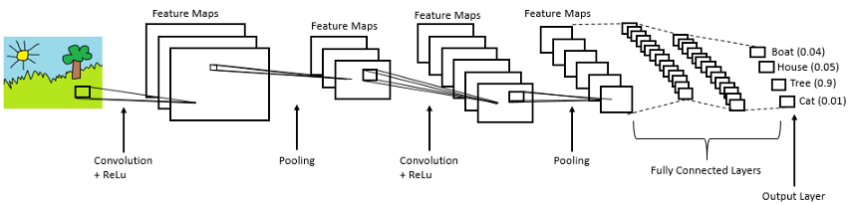
Introduction to TensorFlow for Deep Learning and Computer Vision
Damanpreet Kaur
CS 505 – Fall’ 2019

Slide 2
Table of Contents
Overview of Neural Networks
Neural Network
Neural Network Training
Convolution, Pooling, and fully connected layers
Exercise 1 – Understanding and Visualizing tensorflow graph
Exercise 2 – Define wrapper functions required for MNIST
Exercise 3 – Define model layers (Fashion MNIST)
Exercise 4 – Define saver to save the model weights (Fashion MNIST)
Exercise 5 – Loading model and Inference (Fashion MNIST)

Slide 3
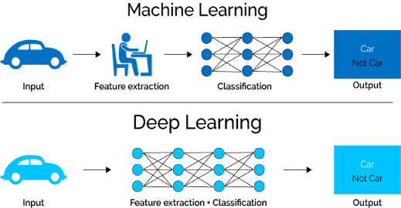
Machine Learning vs Deep Learning
Notes:
Source: https://lawtomated.com/wp-content/uploads/2019/04/MLvsDL.png

Slide 4



I am unable to see anything as the light is too dim.

Slide 5
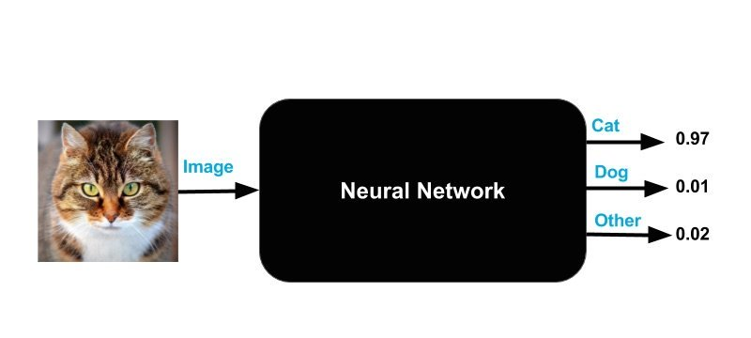
Neural Network
Neural Network as a black box which takes inputs and transforms them into the required outputs. In this figure, it transforms the cat image and classifies it as 97% cat, 1% dog and 2% others.

Slide 6
Neural Network
Input layer
Hidden layer
Output layer
x1*w1 + x2*w2 + x3*w3 + x4*w4 + b1
x1
w1
h1
a1
Motivation
Analogous to the biological systems.
We need to exploit the massive parallelism.
Neural Network Neurons
Receives n inputs + bias term
Multiplies each input by its weight and adds the bias term.
Applies the activation function to add non-linearity.
Outputs the result.
x2
w2
h2
y
x3
w3
w4
x4
h3
Biases
b1
b2

Slide 7
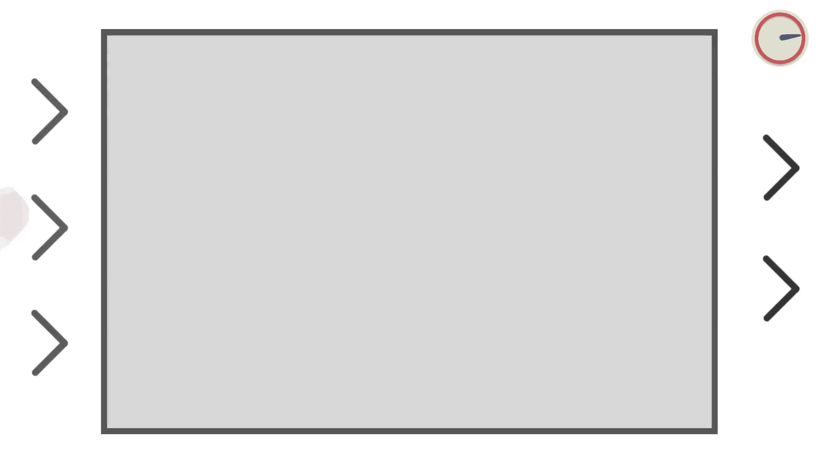
Notes:
Source: https://www.youtube.com/watch?v=rEDzUT3ymw4

Slide 8
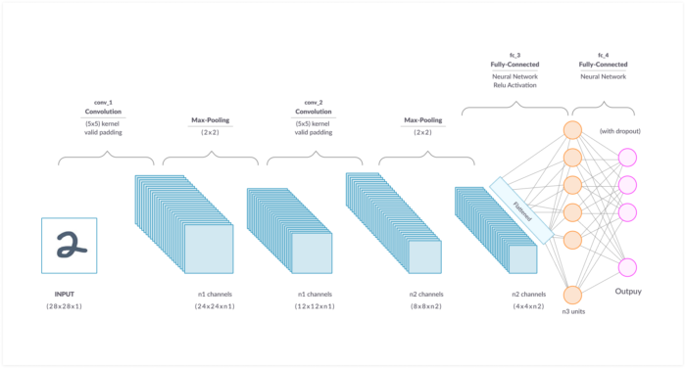

Neural Network Layers
Notes:
Source

Slide 9
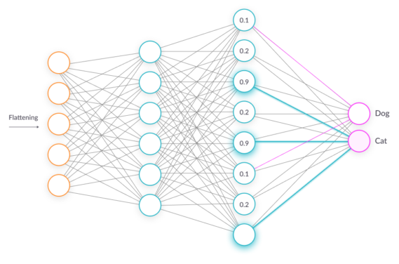
Fully Connected Layer
Every neuron is connected to a neuron in the previous layer, and each connection has it’s own weight.
Cheap way of learning non-linear combinations of the features.
Loss is propagated to hidden nodes. Gradients are fed back and weights are updated.

Slide 10
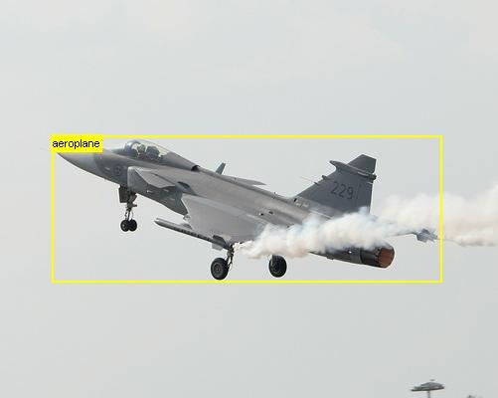
What is the problem with fully-connected layers?
High dimensionality
256 X 256 X 3 image has 256 * 256 * 3 dimensions.
One hidden layer with 1000 neurons will have
256 * 256 * 3 * 1000 connections.
(million of parameters to learn. Too expensive!)

Slide 11

Convolutional layers

Slide 12
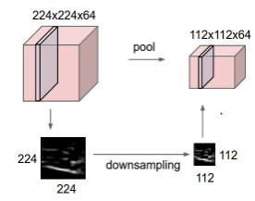
Pooling Layer
Reduce the spatial dimension by preserving the depth information.
Reduces the parameters and speed up computation.
Finding robust features.
Pad = 1, Stride = 2, Filter size 3 X 3 X 3

Slide 13
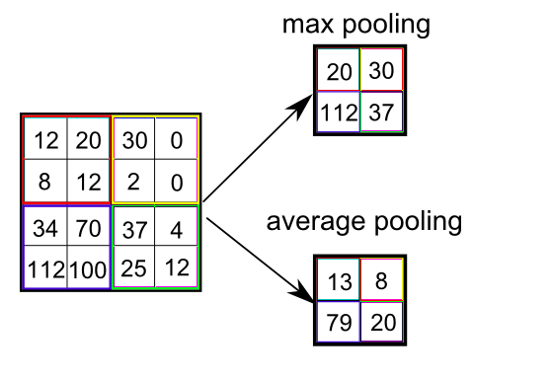
Pooling Layer
Uses a pooling size of 2 X 2.
Max pooling :
Selects the maximum pixel value from 2 X 2 region.
Average pooling:
Averages the pixel values from every 2 X 2 region.
Pad = 1, Stride = 2, Filter size 3 X 3 X 3
Notes:
Source: https://www.quora.com/What-is-max-pooling-in-convolutional-neural-networks

Slide 14
Convolutional Neural Networks
Made up of neurons that have learnable weights and biases.
Convolutional Neural Network is a list of layers that transforms the image volume into an output volume.
ConvNet can consist of one/more layers of the types:
Convolutional Layers, Pooling Layers, Fully connected layers

Slide 15

Notes:
Source: https://adeshpande3.github.io/assets/Cover.png

Slide 16

Google Colab
No setup needed.
Colab provides GPU and it’s totally free!
Tool for machine learning education and research
Notes:
If you have questions setting up google colab, visit:
https://research.google.com/colaboratory/faq.html
you get free 12gb of RAM and access to a virtual machine with a high-end CPU/GPU/TPU
Runs on google VM on the cloud.

Slide 17
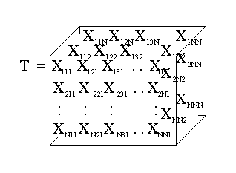
Tensorflow
TensorFlow gets its name from tensors, which are arrays of arbitrary dimensionality.
A scalar is a 0-d array (a 0th-order tensor). For example, "Howdy" or 5
A vector is a 1-d array (a 1st-order tensor). For example, [2, 3, 5, 7, 11] or [5]
A matrix is a 2-d array (a 2nd-order tensor). For example, [[3.1, 8.2, 5.9][4.3, -2.7, 6.5]]
Notes:
Tensors: https://www.youtube.com/watch?v=f5liqUk0ZTw
Source: Tensors Diagram

Slide 18
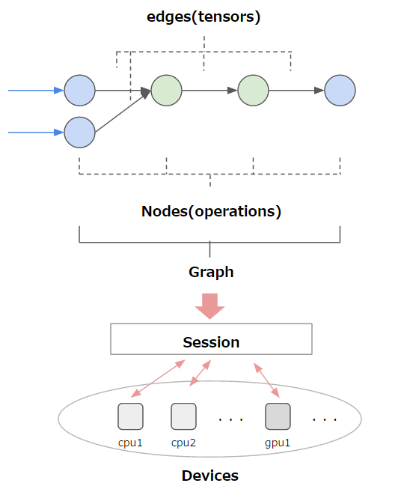
Main Components of TensorFlow
Notes:
Source: https://leonardoaraujosantos.gitbooks.io/artificial-inteligence/tensorflow.html

Slide 19
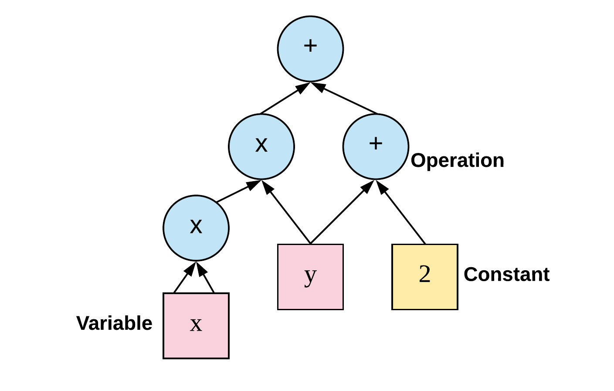
Exercise - Tensorflow Graphs
Notes:
Source: https://www.easy-tensorflow.com/tf-tutorials/basics/graph-and-session

Slide 20

Let’s get coding!

Slide 21
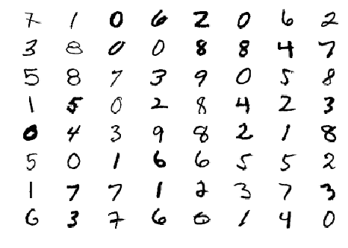
MNIST Dataset
Dataset with handwritten digits

Slide 22
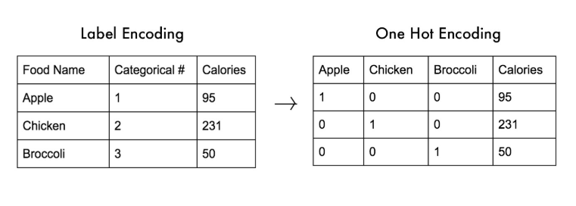
Label vs One-hot encoding
SOURCE: https://medium.com/@michaeldelsole/what-is-one-hot-encoding-and-how-to-do-it-f0ae272f1179

Slide 23
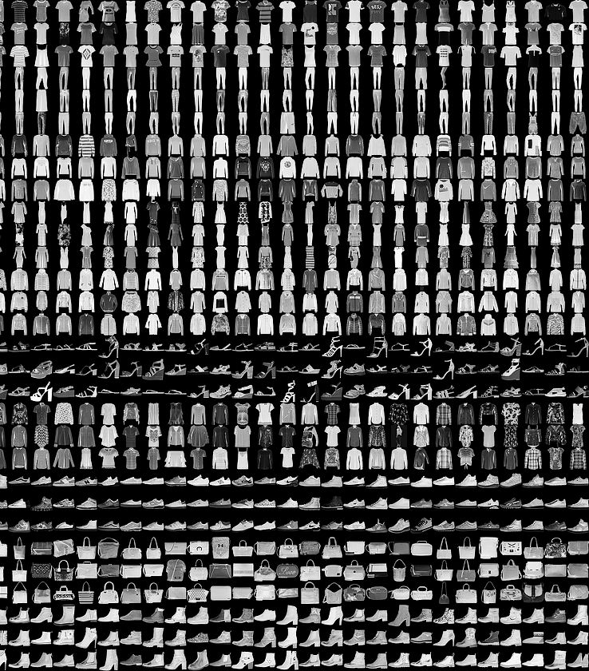
Fashion MNIST Dataset
Fashion Product Database
Notes:
Created by e-commerce company, Zalando.
Similar to the MNIST digit dataset, the Fashion MNIST dataset includes:
60,000 training examples
10,000 testing examples
10 classes
28×28 grayscale/single channel images
class labels:
0 T-shirt/top
1 Trouser/pants
2 Pullover shirt
3 Dress
4 Coat
5 Sandal
6 Shirt
7 Sneaker
8 Bag
9 Ankle boot
https://www.datacamp.com/community/tutorials/cnn-tensorflow-python

Slide 24
Some useful links:
https://research.google.com/seedbank
https://developers.google.com/machine-learning/crash-course/first-steps-with-tensorflow/toolkit
http://neuralnetworksanddeeplearning.com/chap1.html
https://github.com/chiphuyen/stanford-tensorflow-tutorials.git

Slide 25
References
https://towardsdatascience.com/image-classifier-cats-vs-dogs-with-convolutional-neural-networks-cnns-and-google-colabs-4e9af21ae7a8
http://cs231n.github.io/convolutional-networks/
https://www.datacamp.com/community/tutorials/tensorflow-tutorial
https://research.google.com/seedbank/guide/faq

Slide 26
Extra Readings

Slide 27
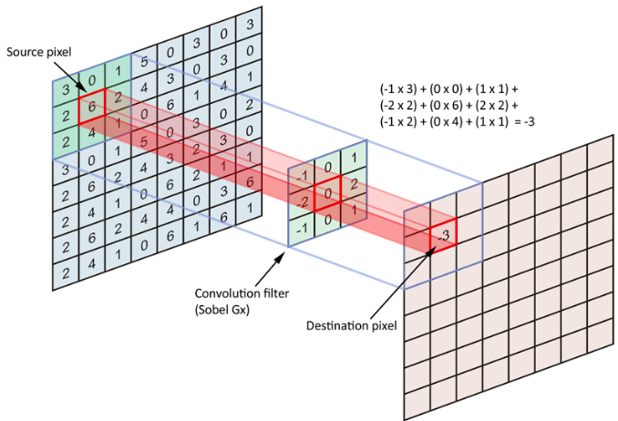
Convolutional layers
Notes:
Sparsity of connections: in each layer, each output value is connected only on small number of inputs.
Mathematics behind Convolution - https://towardsdatascience.com/gentle-dive-into-math-behind-convolutional-neural-networks-79a07dd44cf9

Slide 28
Main Components of TensorFlow

